Slide 1
Tutorial 3
Estimation Techniques
SOEN 384

Slide 2
Overview
Objective:
  Use fundamental estimation techniques for estimating work effort
  Follow the examples and answer Exercise 1-3
SOEN 384

Slide 3
Count, Compute, Judge
Count if at all possible, compute when you can’t count. Use judgment alone only as a last resort.
Look for something you can count that is a meaningful measure of the scope of work in your environment.
Collect historical data that allows you to compute an estimate from a count.
  Average effort hours per class for development.
  Count number of classes
  Compute.
SOEN 384
Notes:
Count:
1.Find something to count that's highly correlated with the size of the software you're estimating
2.Find something to count that's available sooner rather than later in the development cycle The
3.Find something to count that will produce a statistically meaningful average. Find something that will produce a count of 20 or more. Statistically, you need a sample of at least 20 items for the average to be meaningful.
4.Understand what you're counting
Compute:
1.Use Computation to Convert Counts to Estimates
2.Eg. Average effort hours per feature for development and/or testing
Judgement
1. informal or intuitive judgment without ground analysis support is the least accurate means of estimation. Estimates seem to be the most accurate if they can be tied to something concrete.
2. Historical data combined with computation is remarkably free from the biases that can undermine more judgment-based estimates.

Slide 4
Individual Expert Judgment (1)
To create the task-level estimates, have the people who will actually do the work create the estimates
Separate large tasks into smaller tasks
  (Forward reference: Decomposition and Recomposition)
Create both Best Case and Worst Case estimates to simulate thinking about the full range of possible outcomes.
ExpectedCase =
[BestCase + (4* MostLikelyCase) + WorstCase] / 6.
SOEN 384
Notes:
Who Creates the Estimates
Individual expert judgment is by far the most common estimation approach used in practice(Jørgensen 2002)
When discussing "expert judgment," we need first to ask "expert in what?“
3. For the estimation of specific tasks—such as the time needed to code and debug a particular feature or to create a specific set of test cases—the people who will actually do the work will create the most accurate estimates.
Granularity
One of the best ways to improve the accuracy of task-level estimates is to separate large tasks into smaller tasks. When creating estimates, developers, testers, and managers tend to concentrate on the tasks that they understand and deemphasize tasks that are unfamiliar to them.

Slide 5
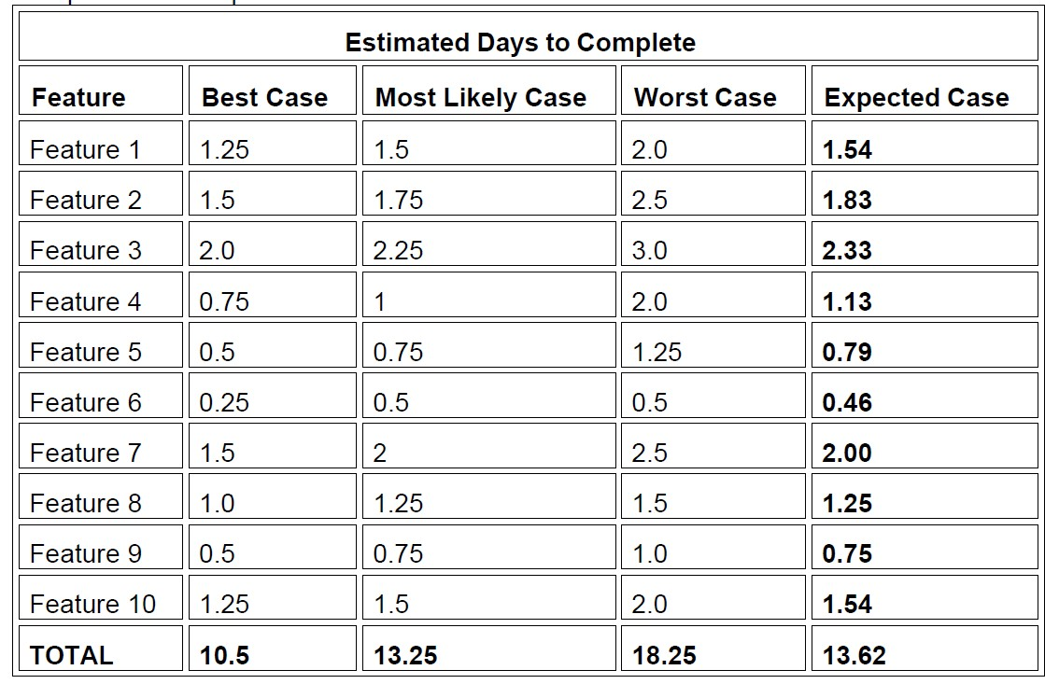
Example of expert judgement using PERT
SOEN 384

Slide 6
Individual Expert Judgment (2)
Compare Estimates to Actuals
Magnitude of Relative Error (MRE)
  MRE (Feature) =
  [ActualResult – EstimatedResult] / ActualResult
  MMRE (project) = average of MRE(Feature)
Analyze your judgment results to avoid making mistakes in the future
SOEN 384

Slide 7
Estimation by Analogy(1)
Estimate new projects by comparing them to similar past projects, preferably decomposing the estimate
Do not address estimation uncertainty by biasing the estimate. Address uncertainty by expressing the estimate in uncertain terms.
SOEN 384
Notes:
1.Before the new project, there was a companion project which was successful. you can create accurate estimates for a new project by comparing the new project to a similar past project.
2. eg. "The comparison to most of the old system is pretty straightforward, but the business rules part is a little tough," Jennifer said. "We think it's going to be more complicated than the old system, but we're not sure how to put a number on it. We've talked it over, and our feeling is that it's at least 50% more complicated than the old system."

Slide 8
Estimation by Analogy(2)
What’s estimated:
  Size, Effort, Schedule, Features
Step 1: Get detailed size, effort, cost results for a similar previous project
  Find the subsystems (DB, UI, Graphs/reports, Foundation classes, Business rules,…)
  Find the number of elements such as tables in DB, web pages each subsystem
  Scope out the new system
SOEN 384

Slide 9
Estimation by Analogy(3)
Step 2: Compare the size of the new Project to a similar past project
  Multiplication factor (subsystem)=
  (number of elements in New) /
  (number of elements in Old)
SOEN 384

Slide 10
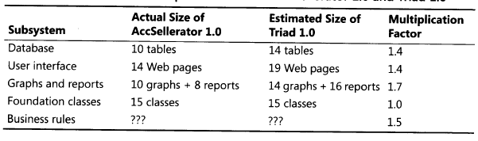
Example: AccSellerator is a past project, Triad is a new similar project
SOEN 384

Slide 11
Estimation by Analogy(4)
Step 3: Build up estimate for the size of the new Project
  Size (new subsystem) = Size (old subsystem) * Multiplication factor
  Size (New project) = sum of the sizes of its subsystems
SOEN 384

Slide 12
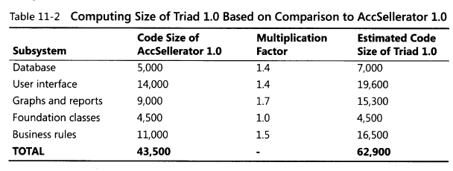
Example (cont.)
SOEN 384

Slide 13
Estimation by Analogy(5)
Step 4: Create an effort estimate based on the size of the new Project
  Size Ratio =
  Size(New Project)/Size (Old Project)
  Estimated Effort (New Project) =
  Effort (Old Project) * Size Ratio
SOEN 384

Slide 14
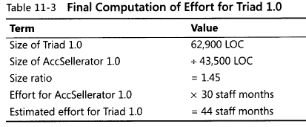
Example (cont.)
SOEN 384

Slide 15
Estimation by Analogy(5)
If uncertain in a case of a subsystem:
  produce an effort range
    For instance, factor of 0.75 to 2.25 for 50% uncertainty
SOEN 384

Slide 16
GROUP REVIEWS
Have each team member estimate pieces of the project individually, and then meet to compare estimates
Discuss the differences among the individual results
Average your estimates
Arrive at a consensus estimate that the whole group accepts
SOEN 384

Slide 17
Practice 1
Giving the estimations of the experts for the system below, use PERT technique to estimate how many days are required to complete the tasks related to Release 1
Feature | Best case | Most likely case | Worst case
Feature 1 | 2.75 | 3.25 | 4
Feature 2 | 1 | 1.5 | 2.5
Feature 3 | 3.5 | 4 | 5
Feature 4 | 2.25 | 2.5 | 3.5
Feature 5 | 0.5 | 0.75 | 1.5
SOEN 384

Slide 18
Practice 2: estimation by analogy
Consider the table below. Based on the estimation by analogy, what is the estimated effort for developing YD, considering that the effort for developing a similar system (SmartDriver) took 50 staff-months? Round to two decimals when making your calculations.
Subsystem-Units | Actual Size of SmartDriver | Estimated Size of YD
Database, tables | 10 | 17
User interface, web pages | 25 | 27
Graphs and reports, reports | 10 | 12
Foundation classes, classes | 20 | 35
Business rules | 50 | 50
Subsystem | Size of SmartDriver (LOC)
Database | 5,000
User interface | 14,000
Graphs and reports | 9,000
Foundation classes | 4,500
Business rules | 11,000
Total | 43,500
SOEN 384

Slide 19
Practice 3: estimation using CoCoMo model
You are hired to develop a new project from scratch given it a very low rating for precedentedness
Development flexibility is nominal, and requirements are stable, so the risk resolution exponent is rated average
Due to COVID-19 all dev. team is working remotely which leads to team cohesion rated as low. In addition, the company is known to be relax in its standards and procedures, hence, the process maturity driver has therefore given a rating of low
What would be the scale factor in this case?
What would be the estimate of effort if the size of the application was estimated as 9300 LOC?
SOEN 384

